Slide 1



ABP Community Talks 2022.6
ABP Framework v6.0 & OpenIddict Migration

Slide 2

Agenda
ABP Community news
Highlights from the ABP v6.0 RC
Story and state of the OpenIddict migration
Questions & Answers

Slide 3
Thanks to the sponsors

Slide 4
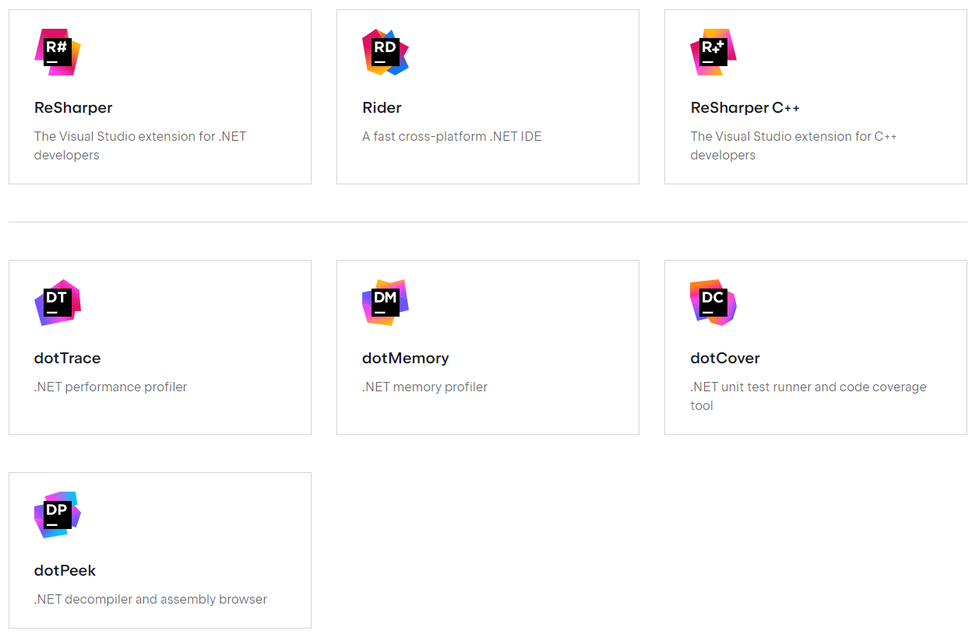
Gift: JetBrains dotUltimate (x3)

Slide 5
ABP.IO Platform v6.0 news https://blog.abp.io/abp/ABP.IO-Platform-6.0-RC-Has-Been-Published
ABP Framework
Migrated to OpenIddict from IdentityServer4
LeptonX is the default theme now
Optional PWA support for the startup templates
New .NET MAUI startup template
ABP Commercial
New .NET MAUI mobile application
GDPR module: Cookie consent
Blazor UI for the chat and CMS Kit modules

Slide 6
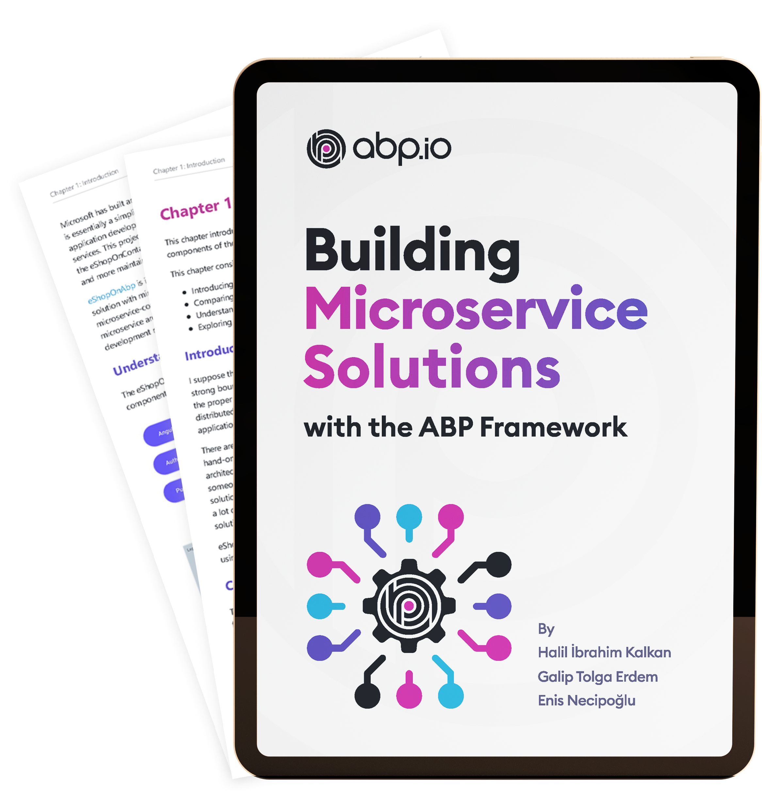
eShopOnAbp: Free E-Book (early preview) https://abp.io/books/building-microservice-solutions
Table of Contents
Introduction (completed)
Running the solution (completed)
Understanding the authentication system (completed)
Exploring the applications
Understanding the API gateways
Developing the microservices
Understanding the infrastructure
Digging in the use cases
Deploying the solution

Slide 7
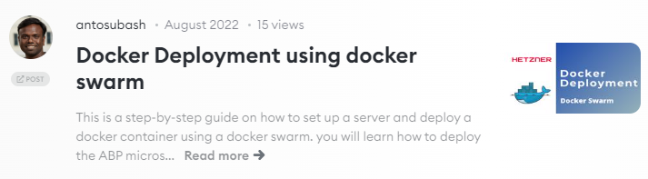
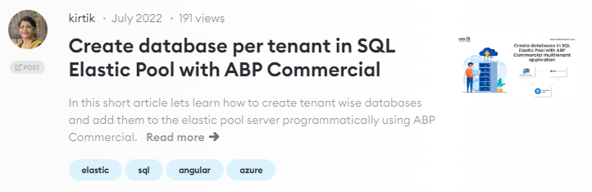
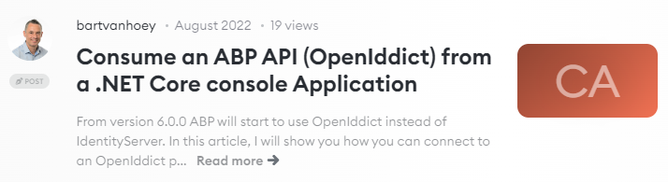
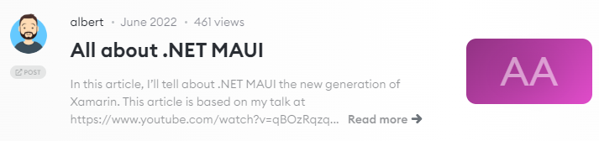
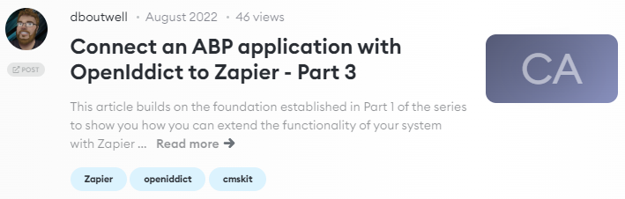
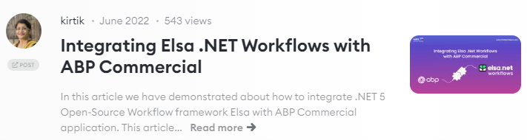
ABP Community Posts https://community.abp.io

Slide 8
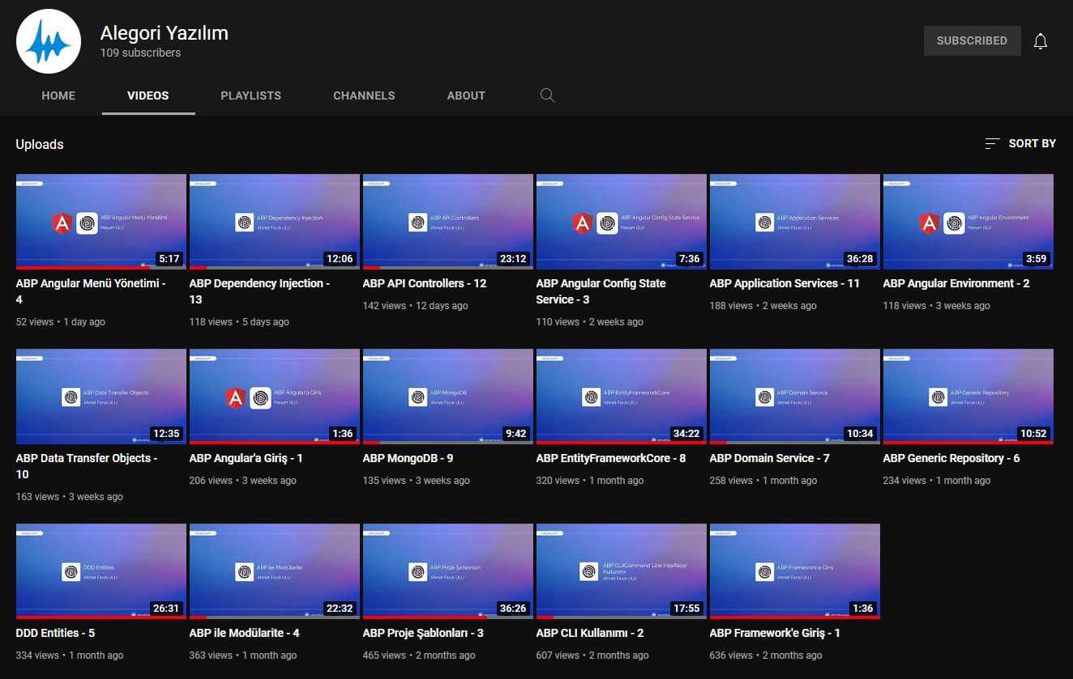
ABP Video Series (in Turkish) by Ahmet Faruk Ulu & Masum Ulu
https://www.youtube.com/c/alegoriyazilim/videos

Slide 9
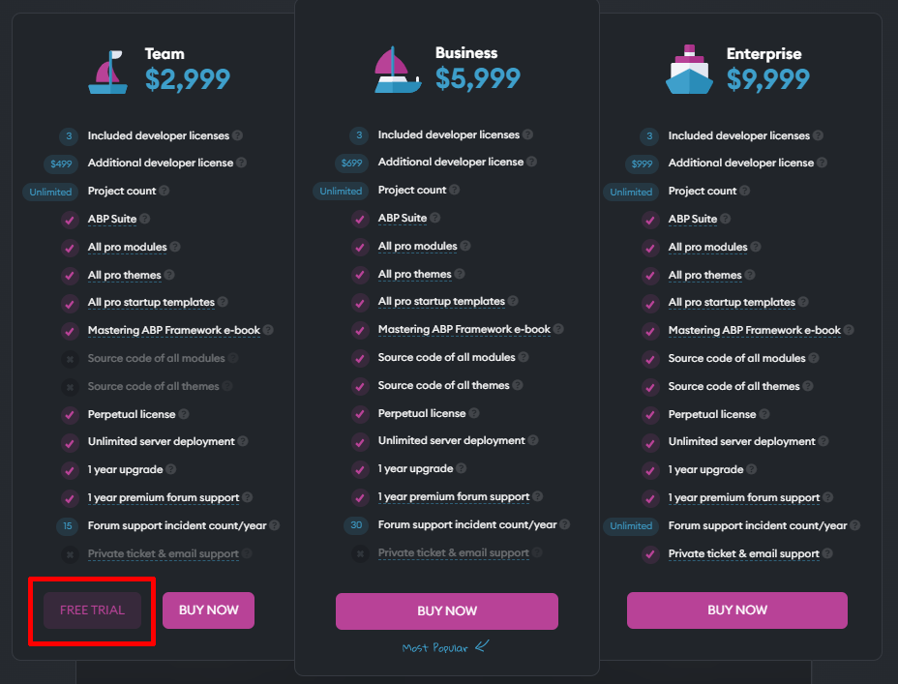
ABP Commercial: Trial License

Slide 10
Title
Todo

Slide 11
Title
Todo

Slide 12
Title
Todo

Slide 13
Title
Todo

Slide 14
Title
Todo

Slide 15
Title
Todo

